Slide 1
Career Autobiography
Lanxiao Bai

Slide 2
About me
Junior of Math & Computer Science
From Sichuan, China 🐼
Former swimming athlete
Software Developer

Slide 3

I thought I will be like...

Slide 4

or...

Slide 5
however...

Slide 6
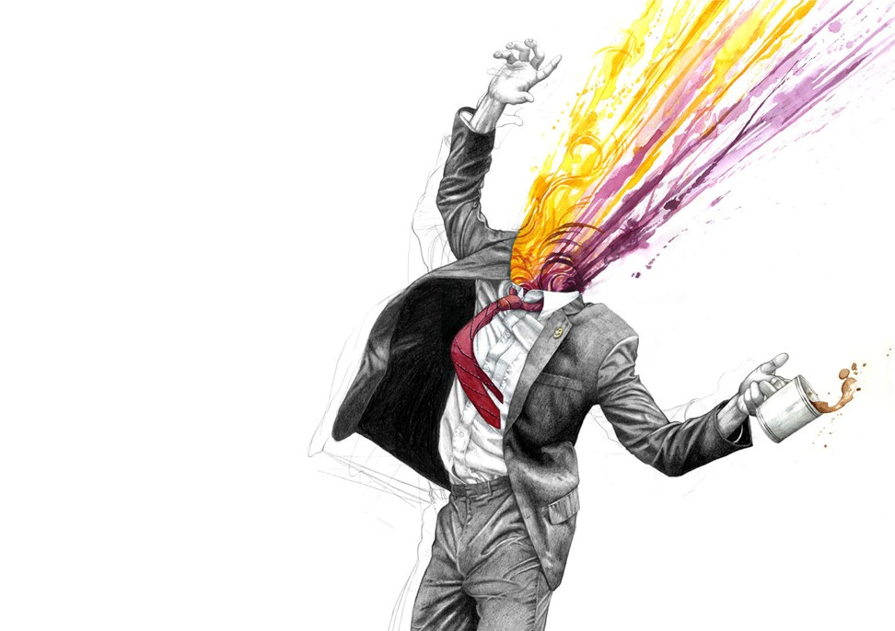
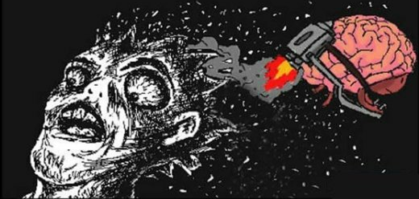
when I'm working

Slide 7

And after that

Slide 8
others think i am...
Smart (hope so)
Energetic
Productive
Self-discipline
Stoic
...

Slide 9
and i think...
Well, maybe they are right (partially), but
Easily distracted sometimes
Sleepy during day time
Not good at exams, at all! Even though sometimes I do mastered all the materials
...

Slide 10
when i was young...
Banker
Because I thought I can earn a lot of money
Dropped the dream for no reason, you know, children’s dream just changes fast sometimes

Slide 11
when i was young
Physicist
Sci-Fi and movies make me feel science is pretty cool
But I realized that it is too difficult for me in high school

Slide 12

At last
I decide I want to become a software engineer just before I enter college
Movies about Hackers and agents
New technologies
Statistics
✈️

Slide 13
working experience
Tech Consultant in Oracle
Work for a CS PhD student on data mining research
Building a financial management app
Will work as a data analyst intern for Bank of America, Chicago

Slide 14
As for barriers
Not really, my parents are always very supportive and will offer good advice sometime
The only thing that bothers me may be that I’m not good at taking exams really, so I got to find a way to overcome it

Slide 15
what i want from work
Income(for sure)
Balanced work and life, really want to stay in the center of lifestyle triangle
location is a plus but not necessary
Opportunity to learn

Slide 16
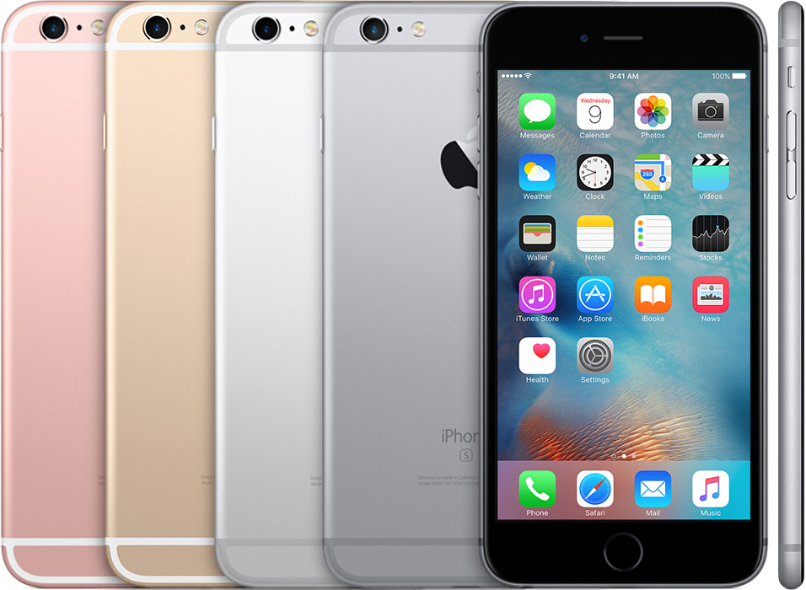
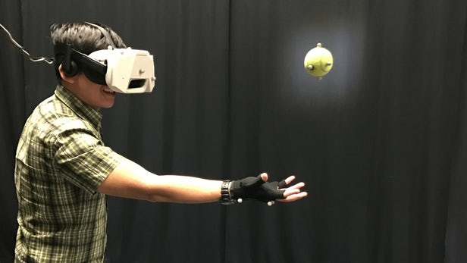
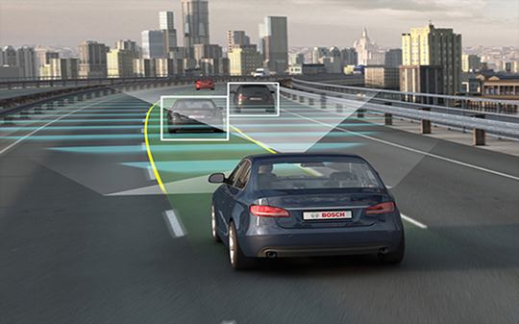
Also
Influence
Innovation that change the world

Slide 17
As for decision making
Pragmatic (may want to avoid occupations that won’t offer considerable salary)
Not very idealistic (sometimes)
So in career decision-making progress, I still tend to value my options before make the final call
Not very patient sometimes, tend to take the best option for now, act intuitively and make modification after review

Slide 18
Identity
Get used to be part of the society but try to be myself
Believe in intuition
Enjoying learning and good at learning

